Slide 1
Looking back: How far have we come? Rétrospective : où en sommes-nous ?
E²M²: Ecological and Epidemiological Modeling in Madagascar
Centre ValBio
Ranomafana National Park, Madagascar
December 2022

Slide 2
Friday: R Bootcamp
Intro to R Studio
Exploring and Visualizing Data in R
For-loops, Functions, and If-Else Statements
● Programming
● Data
● Models
● Research Development
Thursday: “Bells and Whistle”
● Introduction to Phylogenetic Modeling ● Tutorial
● Intoduction to Spatial Visualization and Plotting ● Tutorial
● Modeling Insights from the Metapopulation Game ● Tutorial
● Introduction to Network Modeling ● Tutorial
● Research Snapshots
Saturday: Travel
Sunday: “Getting Started with the Basics”
● Data and Models
● Student introductions & presentations
● Linear regression ● Tutorial
● Formulating research questions
Wednesday: “Refining Your Work”
● Model Fitting in Practice – the Basic Concept
● Epidemic Cards
● Model Fitting with Epidemic Cards
● Model Selection and Comparison
● Model Selection Tutorial
● Model Telephone
Friday: “Putting it All in Perspective”
● The Life Cycle of a Modeling Project
● C4C Student Presentations
Saturday: Travel
Monday: “Using Models with Data”
● Model-Guided Study Design
● Study design tutorial
● Intro to Compartmental Models & Differential Equations
● Building mechanistic models in R
● Refining research questions for modeling
● Defining a model world
January: “Sharing Your Work”
● Final student presentations
Tuesday: “Applying Simple Models”
● Dynamical Fever
● Introduction to Mixed Modeling
● Reading a Research Paper

Slide 3
Friday: R Bootcamp
Intro to R Studio
Exploring and Visualizing Data in R
For-loops, Functions, and If-Else Statements

Slide 4
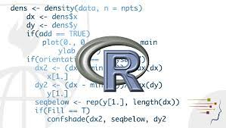
Friday: R Bootcamp
Intro to R Studio
Exploring and Visualizing Data in R
For-loops, Functions, and If-Else Statements

Slide 5
Friday: R Bootcamp
Intro to R Studio
Exploring and Visualizing Data in R
For-loops, Functions, and If-Else Statements
Saturday: Travel
Sunday: “Getting Started with the Basics”
● Data and Models
● Student introductions & presentations
● Linear regression ● Tutorial
● Formulating research questions

Slide 6
What is science? Qu'est ce que la science?
Sunday: “Getting Started with the Basics”
● Data and Models
● Student introductions & presentations
● Linear regression ● Tutorial
● Formulating research questions

Slide 7
What is science? Qu'est ce que la science?
Sunday: “Getting Started with the Basics”
● Data and Models
● Student introductions & presentations
● Linear regression ● Tutorial
● Formulating research questions
the systematic observation of natural events and conditions in order to discover facts about them and to formulate laws and principles
l'observation systématique des événements et des conditions naturelles afin de découvrir des faits à leur sujet et de formuler des lois et des principes fondés

Slide 8
Sunday: “Getting Started with the Basics”
● Data and Models
● Student introductions & presentations
● Linear regression ● Tutorial
● Formulating research questions
What are data? Quelles sont les données?

Slide 9
What are data? Quelles sont les données?
Sunday: “Getting Started with the Basics”
● Data and Models
● Student introductions & presentations
● Linear regression ● Tutorial
● Formulating research questions
evidence to support a claim
preuves à l'appui d'une réclamation

Slide 10
Sunday: “Getting Started with the Basics”
● Data and Models
● Student introductions & presentations
● Linear regression ● Tutorial
● Formulating research questions
What is a model? Qu'est-ce qu'un modèle?

Slide 11
Sunday: “Getting Started with the Basics”
● Data and Models
● Student introductions & presentations
● Linear regression ● Tutorial
● Formulating research questions
What is a model? Qu'est-ce qu'un modèle?
an abstract representation of a phenomenon
une représentation abstraite d'un phénomène

Slide 12
Sunday: “Getting Started with the Basics”
● Data and Models
● Student introductions & presentations
● Linear regression ● Tutorial
● Formulating research questions
What is a model? Qu'est-ce qu'un modèle?
an abstract representation of a phenomenon
une représentation abstraite d'un phénomène
Statistical
Statistique
Mechanistic
Mécaniste

Slide 13
What is a model? Qu'est-ce qu'un modèle?
Sunday: “Getting Started with the Basics”
● Data and Models
● Student introductions & presentations
● Linear regression ● Tutorial
● Formulating research questions
an abstract representation of a phenomenon
une représentation abstraite d'un phénomène
Statistical
Statistique
Mechanistic
Mécaniste
Correlation
Corrélation
Causation
Causalité
What?
Que?
How?
Comment?

Slide 14
Sunday: “Getting Started with the Basics”
● Data and Models
● Student introductions & presentations
● Linear regression ● Tutorial
● Formulating research questions
Formulating research questions Formuler des questions de recherche
Statistical: What is the relationship between increasing temperature and A. gambiae occurrence in Madagascar?
Statistique : Quelle est la relation entre l'augmentation de la température et la présence d'A. gambiae à Madagascar ?

Slide 15
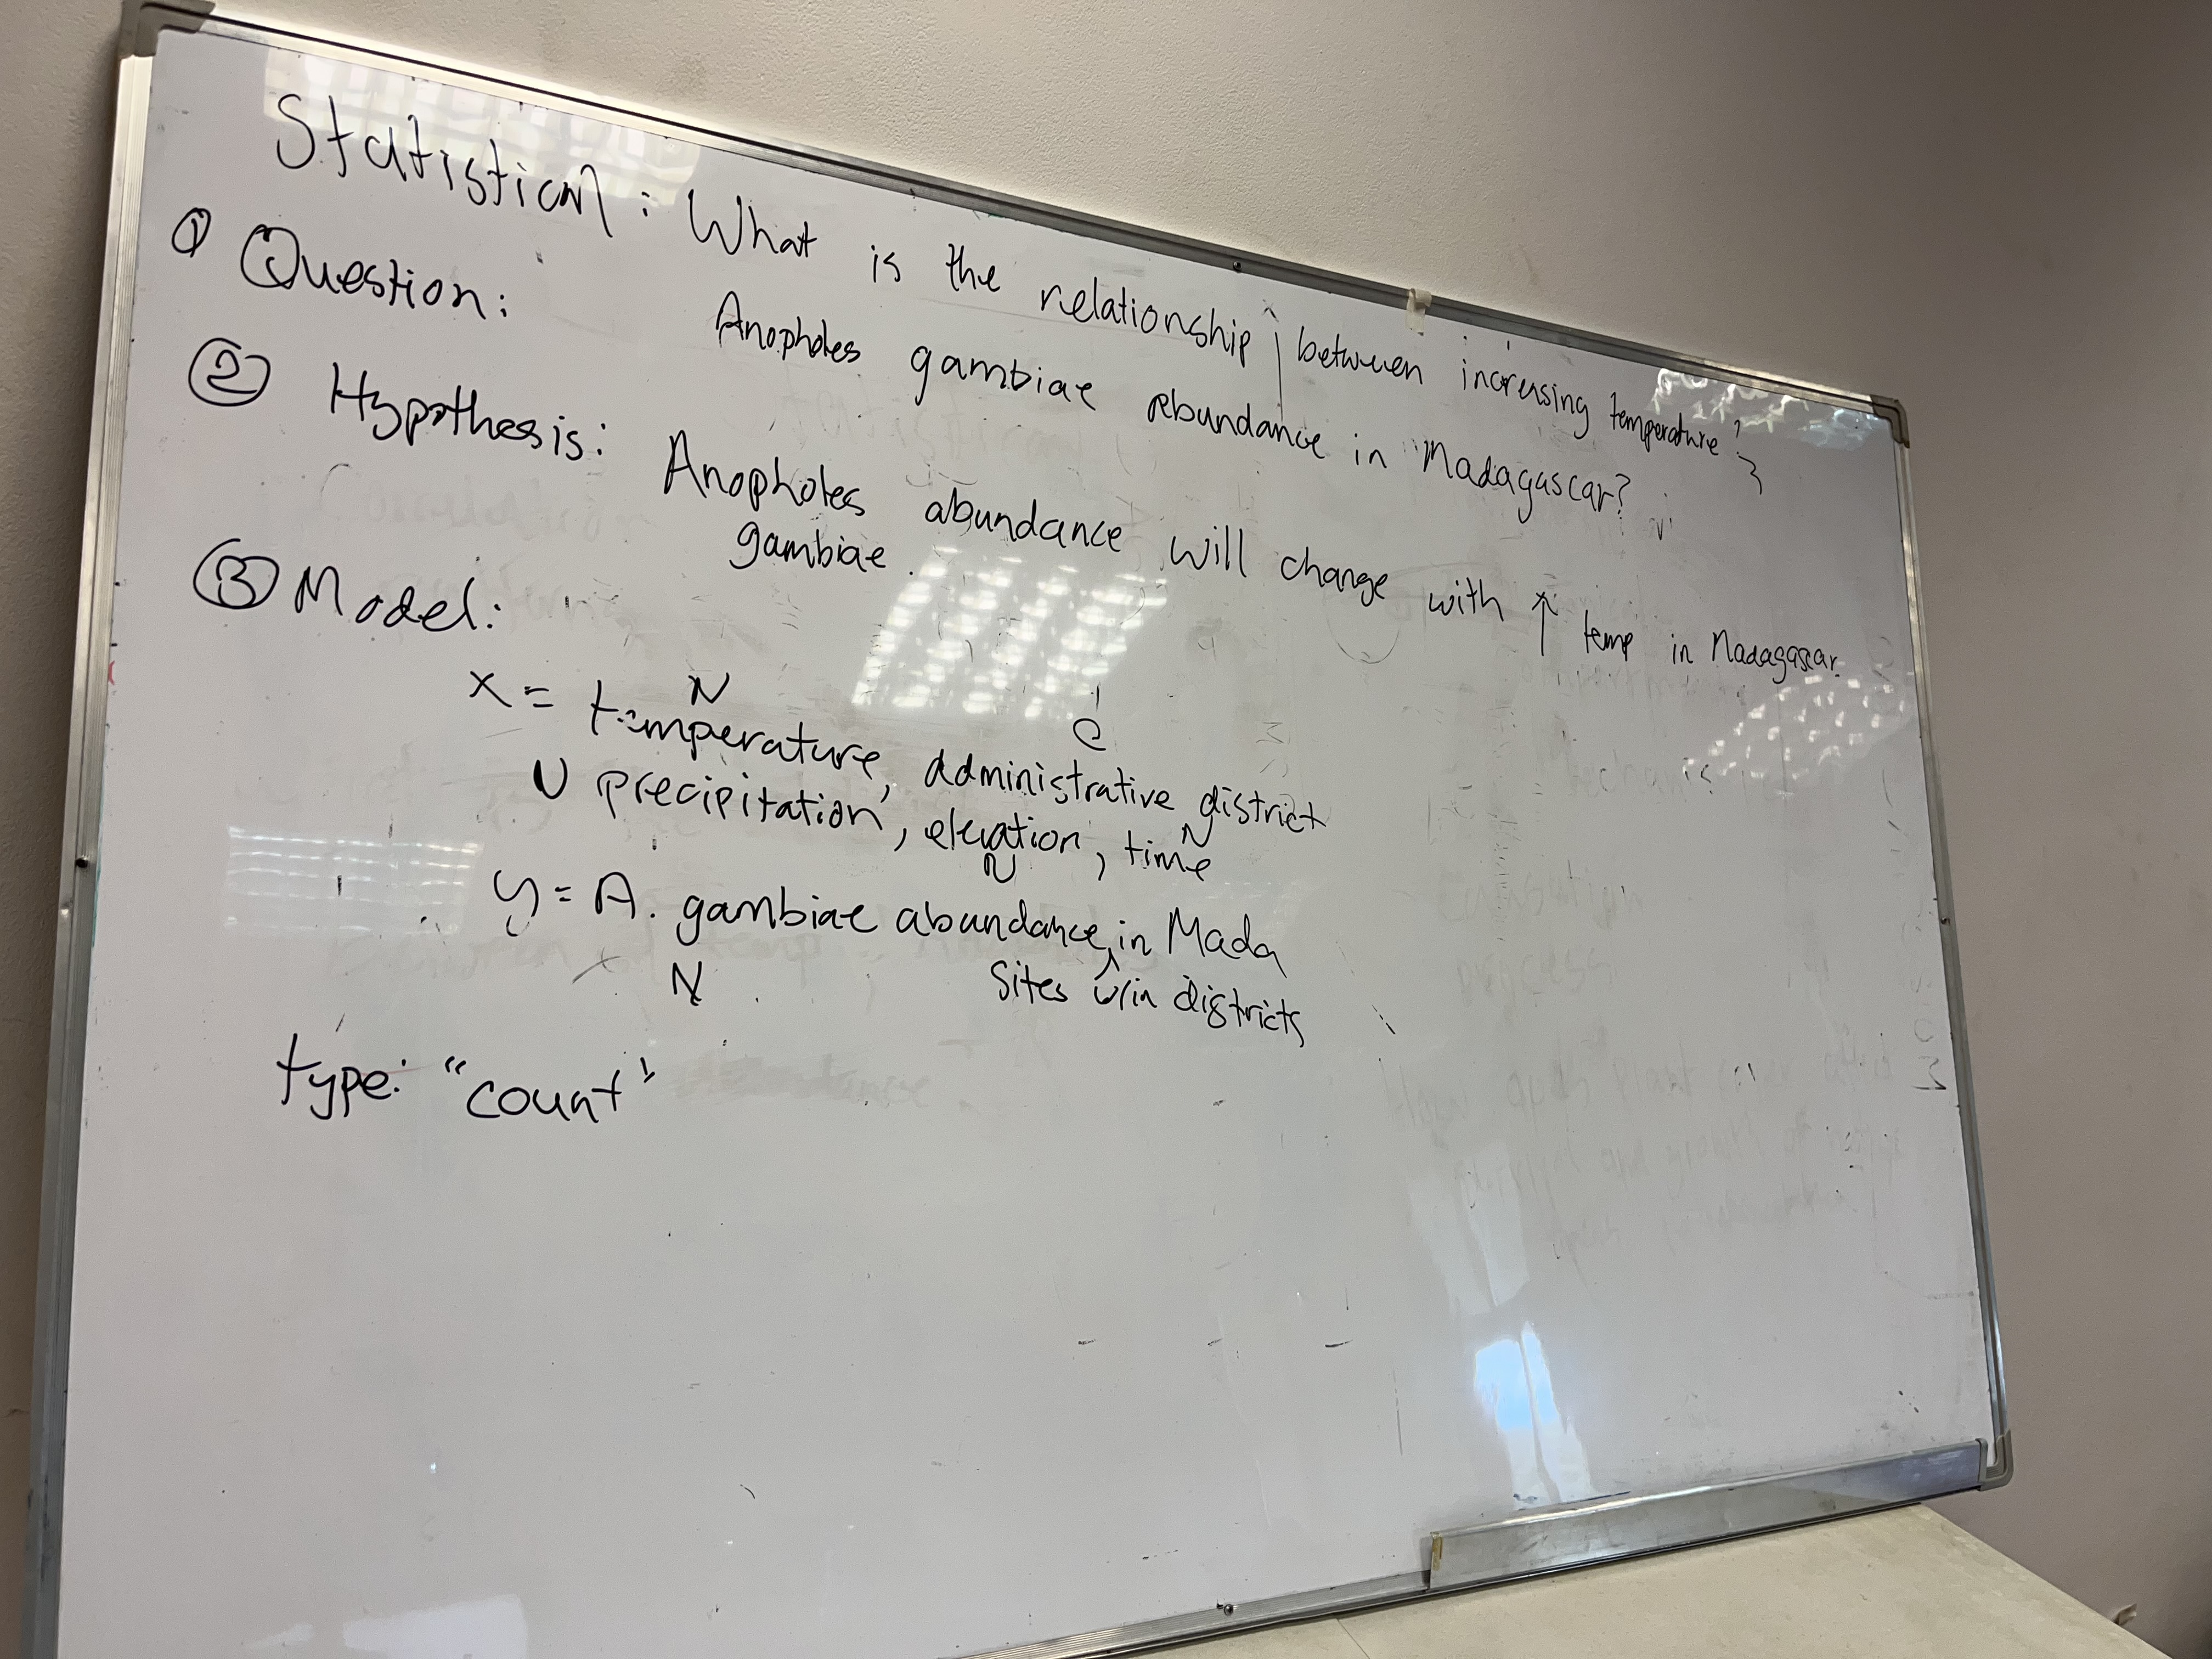
Sunday: “Getting Started with the Basics”
● Data and Models
● Student introductions & presentations
● Linear regression ● Tutorial
● Formulating research questions
Formulating research questions Formuler des questions de recherche
Statistical: What is the relationship between increasing temperature and A. gambiae occurrence in Madagascar?
Statistique : Quelle est la relation entre l'augmentation de la température et la présence d'A. gambiae à Madagascar ?

Slide 16
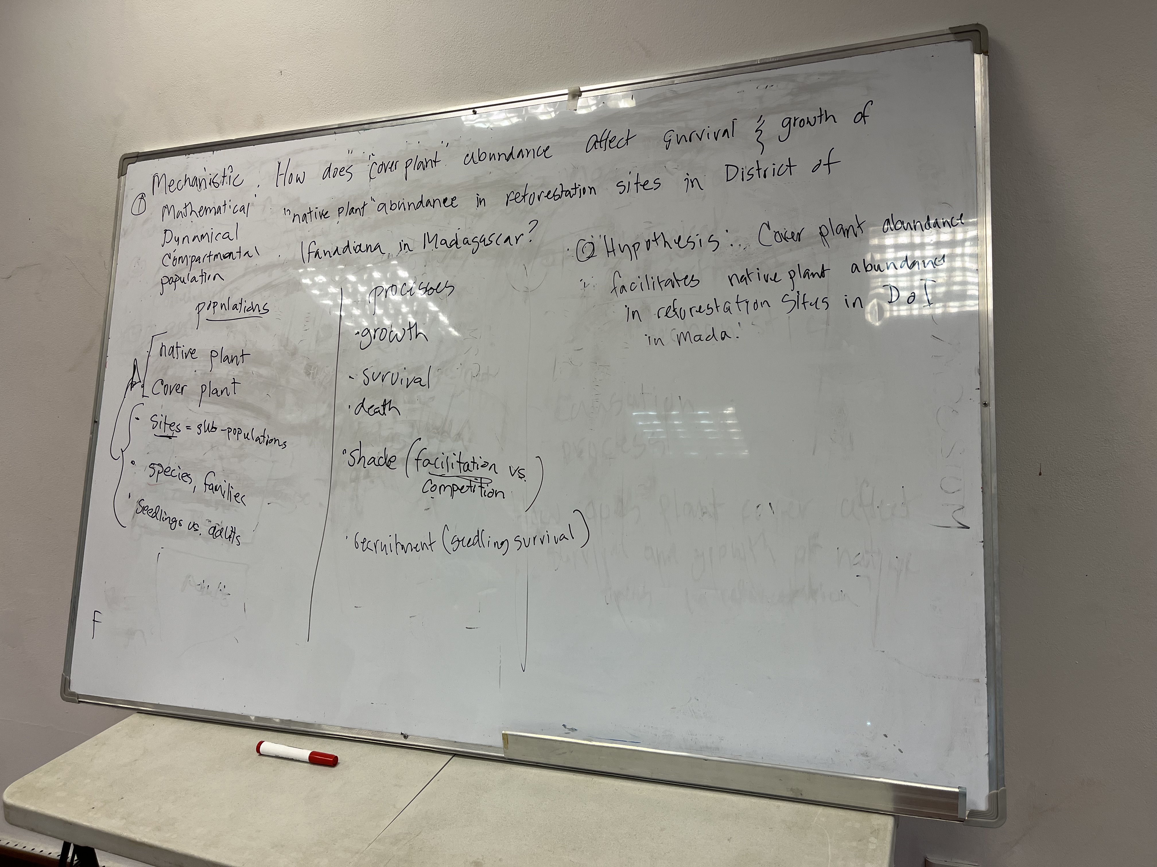
Sunday: “Getting Started with the Basics”
● Data and Models
● Student introductions & presentations
● Linear regression ● Tutorial
● Formulating research questions
Formulating research questions Formuler des questions de recherche
Mechanistic: How does cover plant abundance affect survival and growth of native plants in reforestation sites in the District of Ifanadiana?
Mécaniste : comment l'abondance des plantes de couverture affecte-t-elle la survie et la croissance des plantes indigènes dans les sites de reboisement du district d'Ifanadiana ?

Slide 17
Formulating research questions Formuler des questions de recherche
Sunday: “Getting Started with the Basics”
● Data and Models
● Student introductions & presentations
● Linear regression ● Tutorial
● Formulating research questions
Mechanistic: How does cover plant abundance affect survival and growth of native plants in reforestation sites in the District of Ifanadiana?
Mécaniste : comment l'abondance des plantes de couverture affecte-t-elle la survie et la croissance des plantes indigènes dans les sites de reboisement du district d'Ifanadiana ?

Slide 18
Friday: R Bootcamp
Intro to R Studio
Exploring and Visualizing Data in R
For-loops, Functions, and If-Else Statements
Saturday: Travel
Sunday: “Getting Started with the Basics”
● Data and Models
● Student introductions & presentations
● Linear regression ● Tutorial
● Formulating research questions
Monday: “Using Models with Data”
● Model-Guided Study Design
● Study design tutorial
● Intro to Compartmental Models & Differential Equations
● Building mechanistic models in R
● Refining research questions for modeling
● Defining a model world

Slide 19
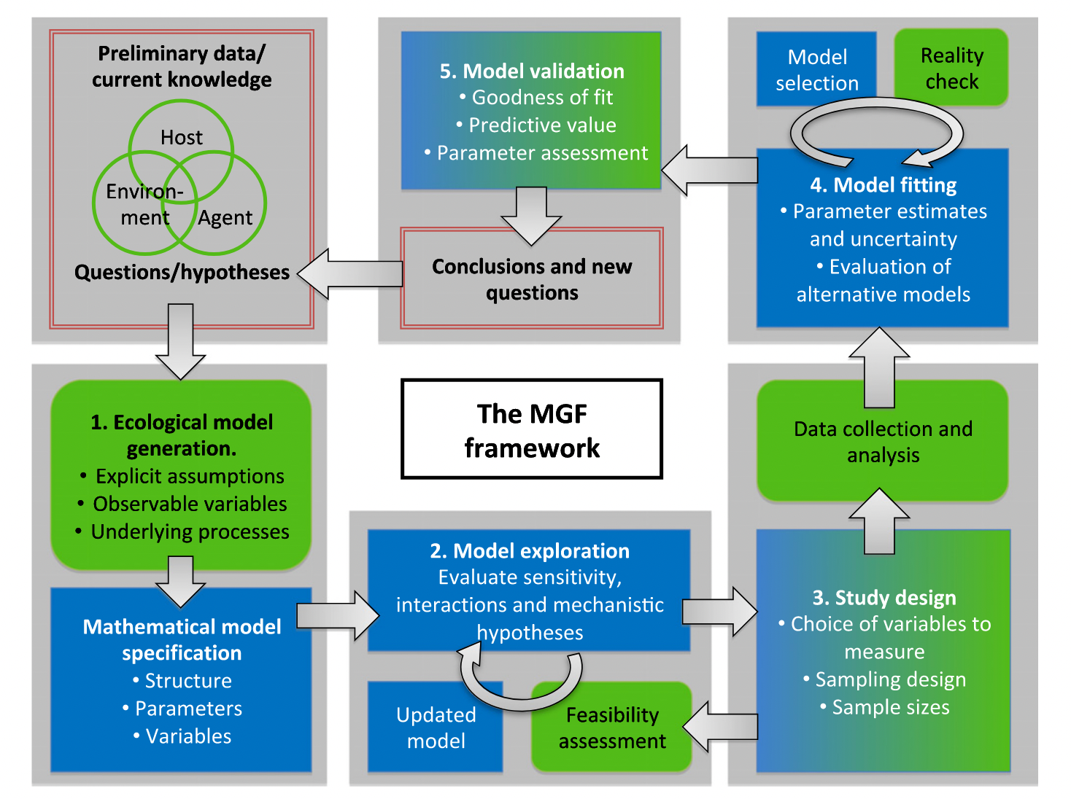
Monday: “Using Models with Data”
● Model-Guided Study Design
● Study design tutorial
● Intro to Compartmental Models & Differential Equations
● Building mechanistic models in R
● Refining research questions for modeling
● Defining a model world
Model-Guided Study Design Conception d'étude guidée par modèle
Restif et al. 2012 Ecology Letters

Slide 20
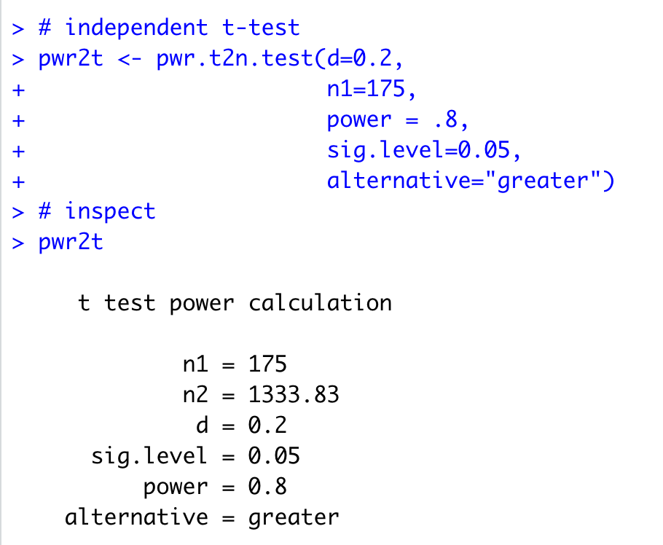
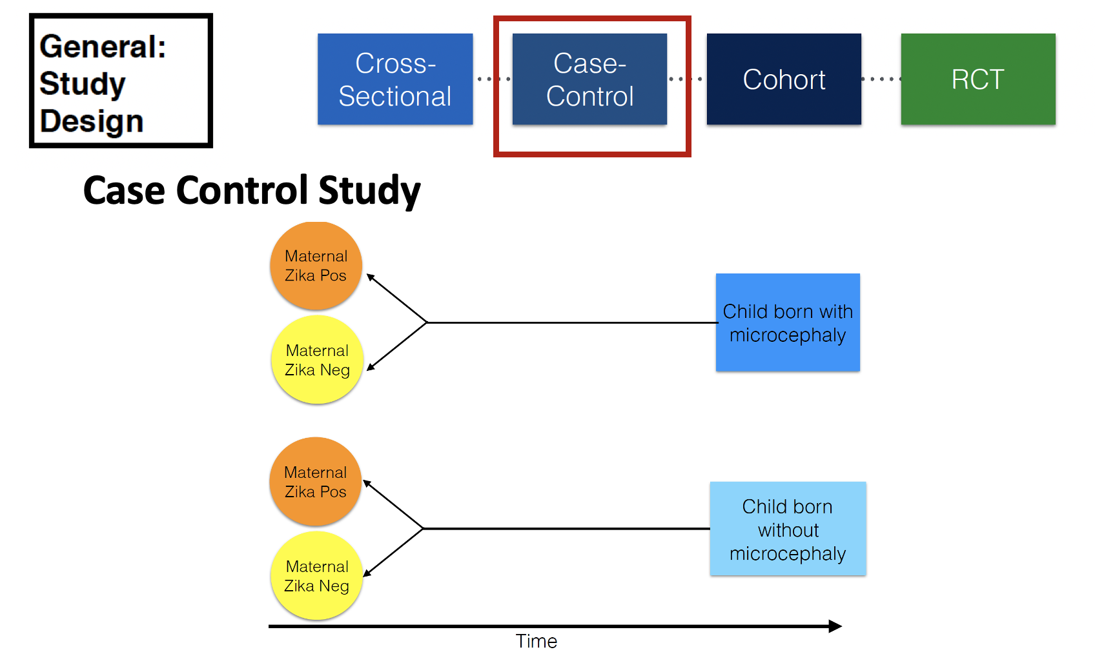
Monday: “Using Models with Data”
● Model-Guided Study Design
● Study design tutorial
● Intro to Compartmental Models & Differential Equations
● Building mechanistic models in R
● Refining research questions for modeling
● Defining a model world
Model-Guided Study Design Conception d'étude guidée par modèle

Slide 21
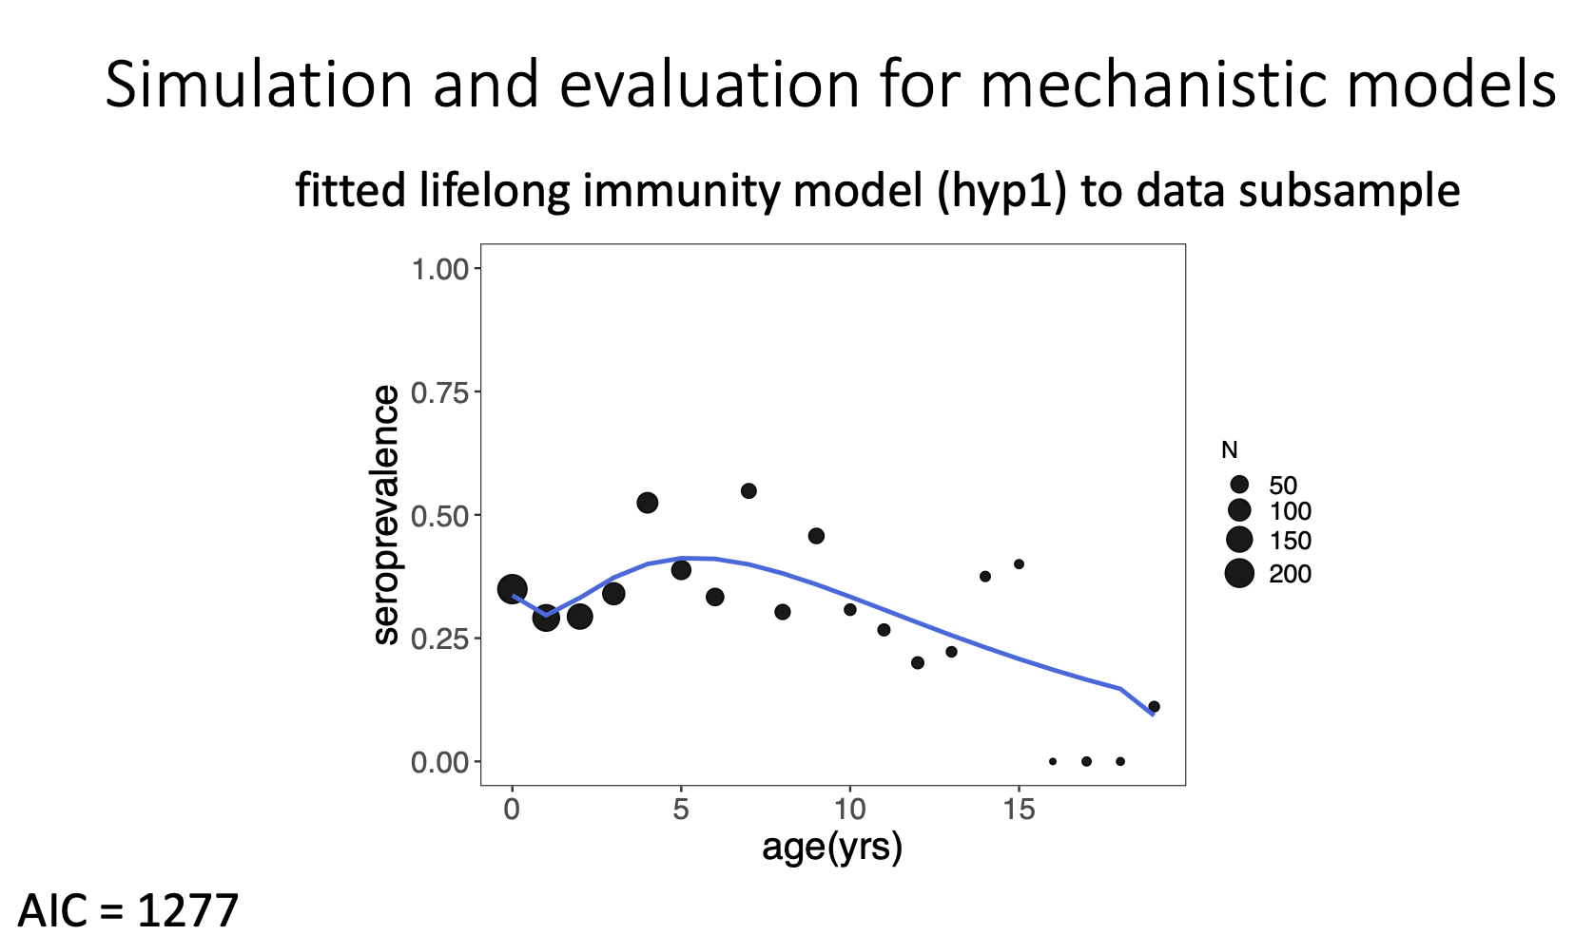
Model-Guided Study Design Conception d'étude guidée par modèle
Monday: “Using Models with Data”
● Model-Guided Study Design
● Study design tutorial
● Intro to Compartmental Models & Differential Equations
● Building mechanistic models in R
● Refining research questions for modeling
● Defining a model world
Restif et al. 2012 Ecology Letters

Slide 22
Monday: “Using Models with Data”
● Model-Guided Study Design
● Study design tutorial
● Intro to Compartmental Models & Differential Equations
● Building mechanistic models in R
● Refining research questions for modeling
● Defining a model world
Intro to Compartmental Models Introduction aux modèles compartimentés

Slide 23
Monday: “Using Models with Data”
● Model-Guided Study Design
● Study design tutorial
● Intro to Compartmental Models & Differential Equations
● Building mechanistic models in R
● Refining research questions for modeling
● Defining a model world
Intro to Compartmental Models Introduction aux modèles compartimentés
Population
Madagascar
(N)
deaths
N_{t+1}=births*N_{t}-deaths*N_{t}

Slide 24
Intro to Compartmental Models Introduction aux modèles compartimentés
Monday: “Using Models with Data”
● Model-Guided Study Design
● Study design tutorial
● Intro to Compartmental Models & Differential Equations
● Building mechanistic models in R
● Refining research questions for modeling
● Defining a model world
Population
Structured Population
births (B)
Madagascar
(N)
deaths
Babies
Adults
aging
(a)
deaths
deaths
N_{t+1}=births*N_{t}-deaths*N_{t}
N_{t+1}=λ*N_{t}

Slide 25
Monday: “Using Models with Data”
● Model-Guided Study Design
● Study design tutorial
● Intro to Compartmental Models & Differential Equations
● Building mechanistic models in R
● Refining research questions for modeling
● Defining a model world
Intro to Compartmental Models Introduction aux modèles compartimentés
Predator-Prey
lemur reproduction
lemur
(x)
Population
Structured Population
births (B)
Madagascar
(N)
lemur death
(depends on fossa population)
deaths
Babies
Adults
aging
(a)
fossa reproduction
(depends on lemur population)
deaths
deaths
fossa
(y)
N_{t+1}=births*N_{t}-deaths*N_{t}
N_{t+1}=λ*N_{t}
fossa death

Slide 26
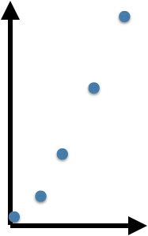
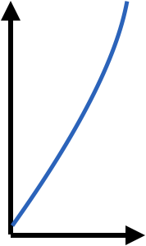
Monday: “Using Models with Data”
● Model-Guided Study Design
● Study design tutorial
● Intro to Compartmental Models & Differential Equations
● Building mechanistic models in R
● Refining research questions for modeling
● Defining a model world
Intro to Compartmental Models Introduction aux modèles compartimentés
Discrete time
Continuous time
population size, N_{t}
population size, N_{t}
time
time

Slide 27
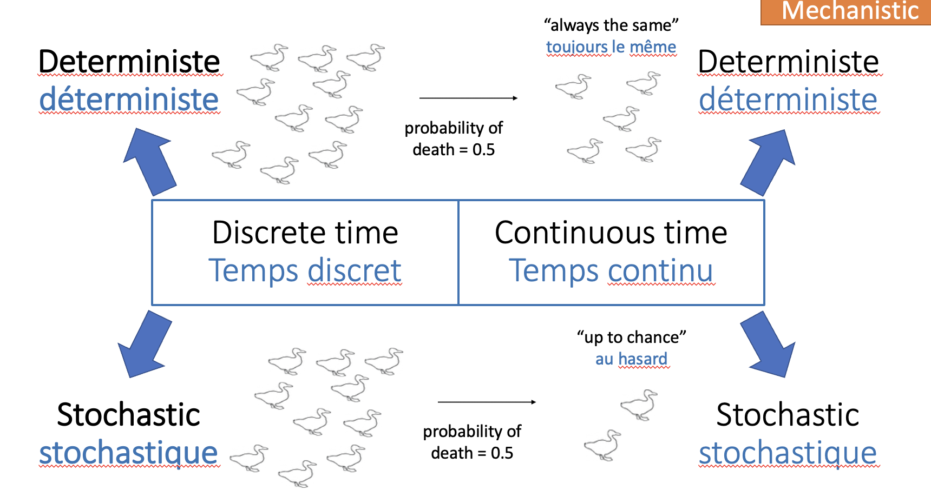
Intro to Compartmental Models Introduction aux modèles compartimentés
Monday: “Using Models with Data”
● Model-Guided Study Design
● Study design tutorial
● Intro to Compartmental Models & Differential Equations
● Building mechanistic models in R
● Refining research questions for modeling
● Defining a model world

Slide 28
Refining research questions for modeling Affiner les questions de recherche pour la modélisation
Monday: “Using Models with Data”
● Model-Guided Study Design
● Study design tutorial
● Intro to Compartmental Models & Differential Equations
● Building mechanistic models in R
● Refining research questions for modeling
● Defining a model world

Slide 29
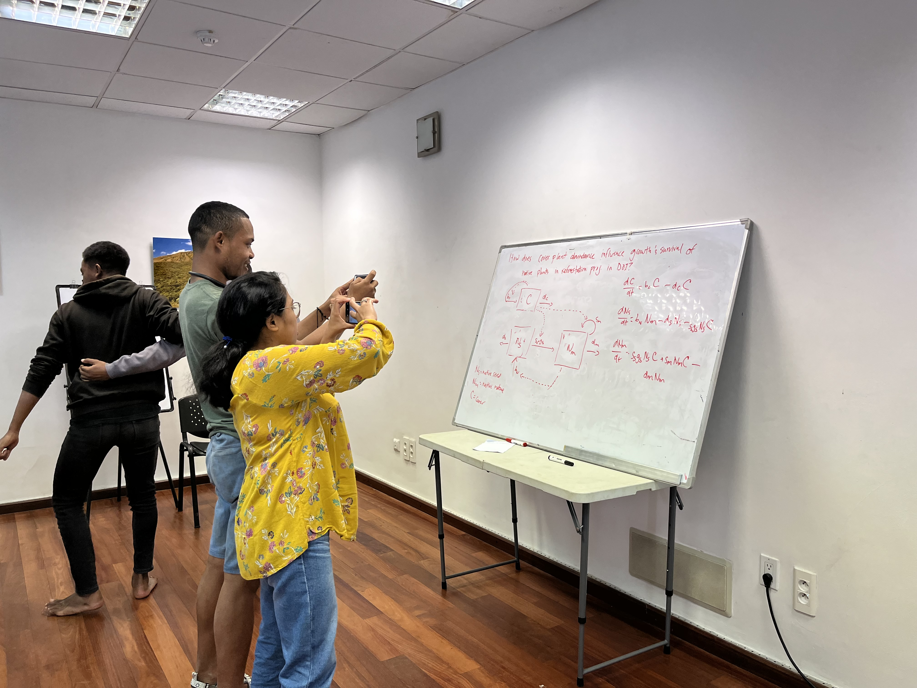
Refining research questions for modeling Affiner les questions de recherche pour la modélisation
Monday: “Using Models with Data”
● Model-Guided Study Design
● Study design tutorial
● Intro to Compartmental Models & Differential Equations
● Building mechanistic models in R
● Refining research questions for modeling
● Defining a model world

Slide 30
Friday: R Bootcamp
Intro to R Studio
Exploring and Visualizing Data in R
For-loops, Functions, and If-Else Statements
Saturday: Travel
Sunday: “Getting Started with the Basics”
● Data and Models
● Student introductions & presentations
● Linear regression ● Tutorial
● Formulating research questions
Monday: “Using Models with Data”
● Model-Guided Study Design
● Study design tutorial
● Intro to Compartmental Models & Differential Equations
● Building mechanistic models in R
● Refining research questions for modeling
● Defining a model world
Tuesday: “Applying Simple Models”
● Dynamical Fever
● Introduction to Mixed Modeling
● Reading a Research Paper

Slide 31
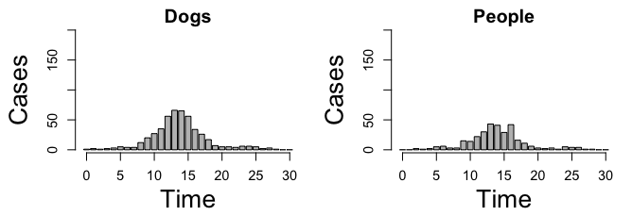
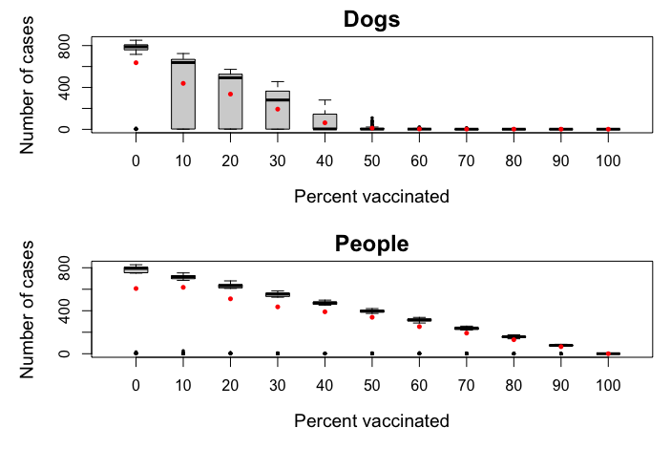
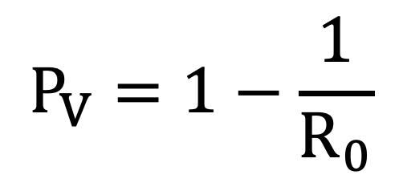
Dynamical Fever Fièvre dynamique
Tuesday: “Applying Simple Models”
● Dynamical Fever
● Introduction to Mixed Modeling
● Reading a Research Paper
$$P_{V}=1−\frac{1}{R_{0}}$$

Slide 32
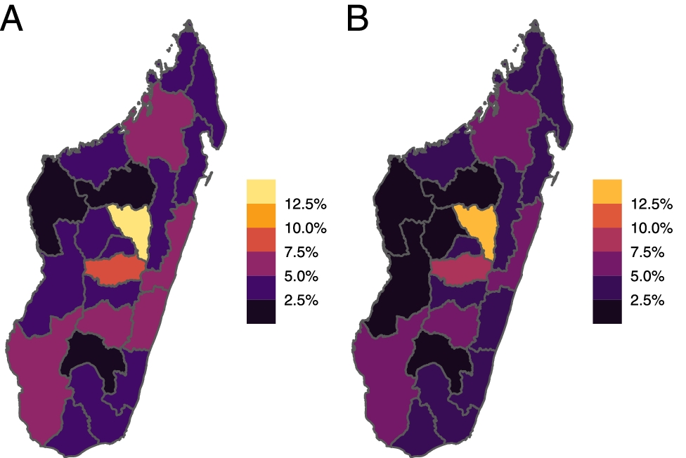
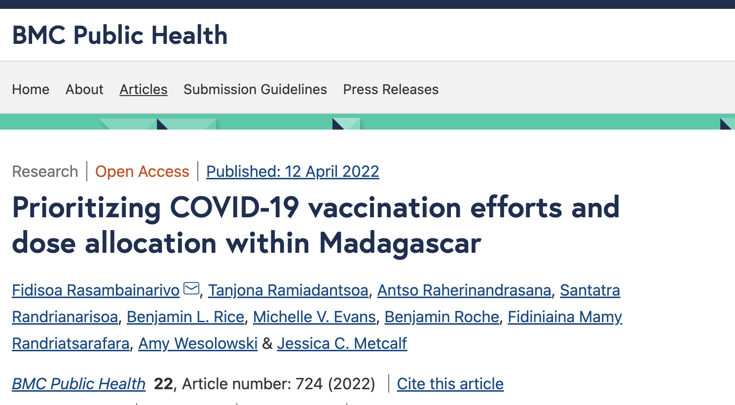
Reading a Research Paper Lire un article scientifique
Tuesday: “Applying Simple Models”
● Dynamical Fever
● Introduction to Mixed Modeling
● Reading a Research Paper

Slide 33
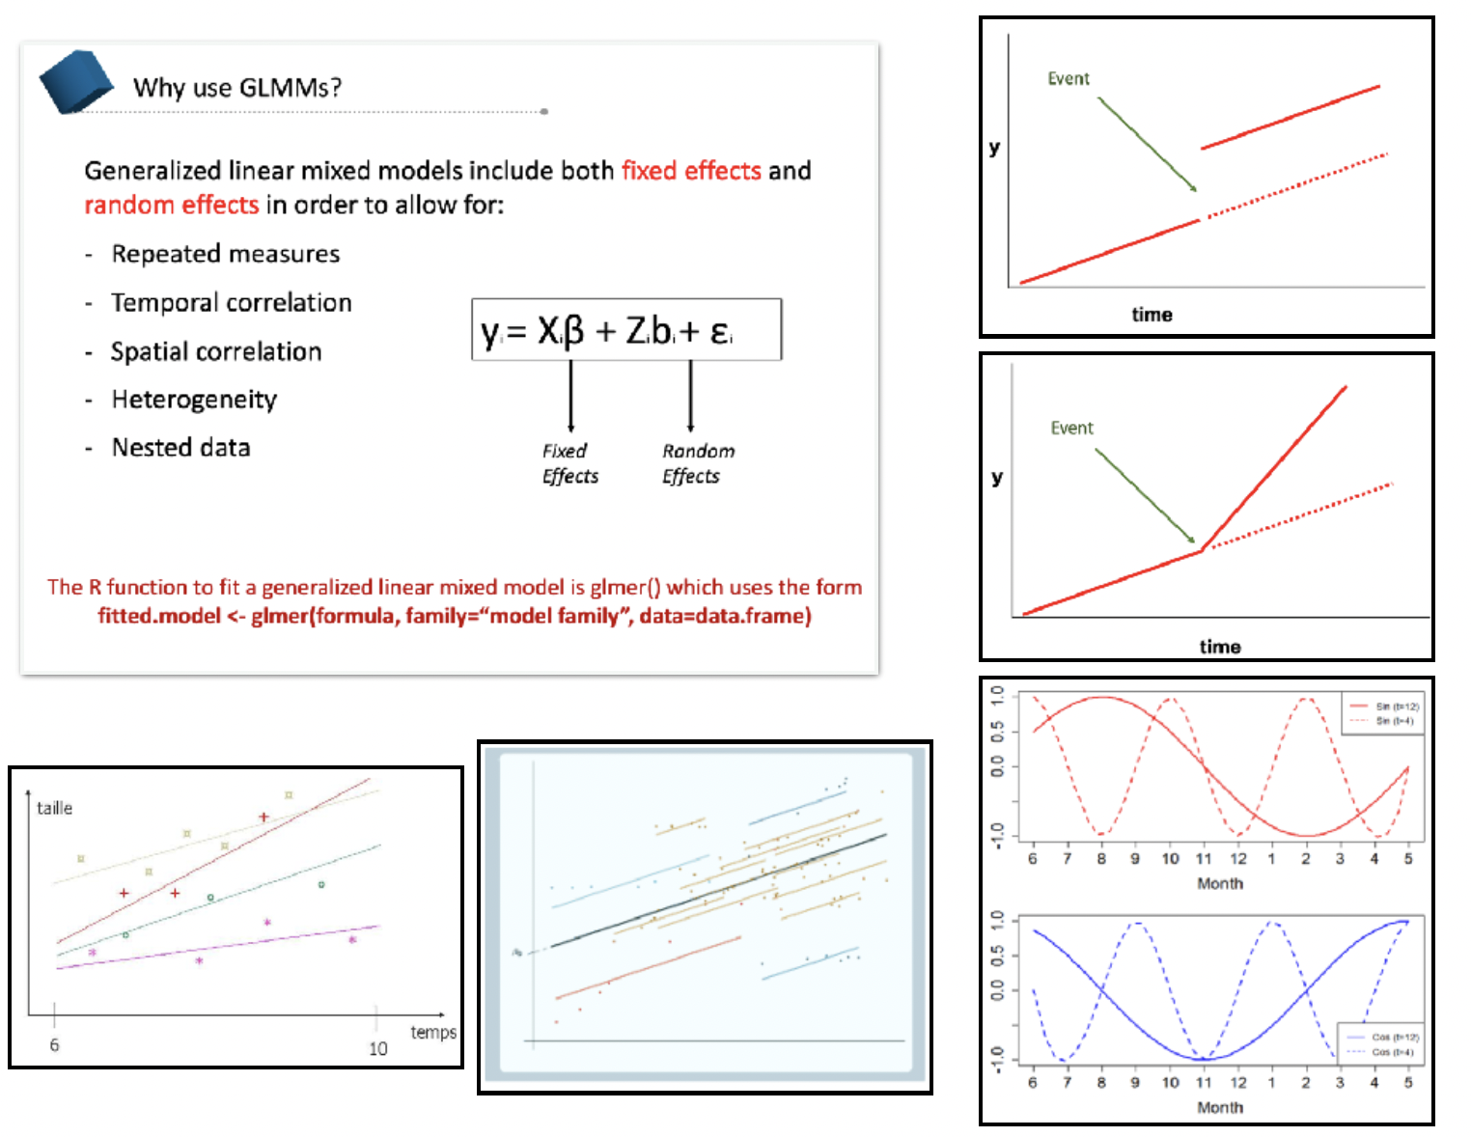
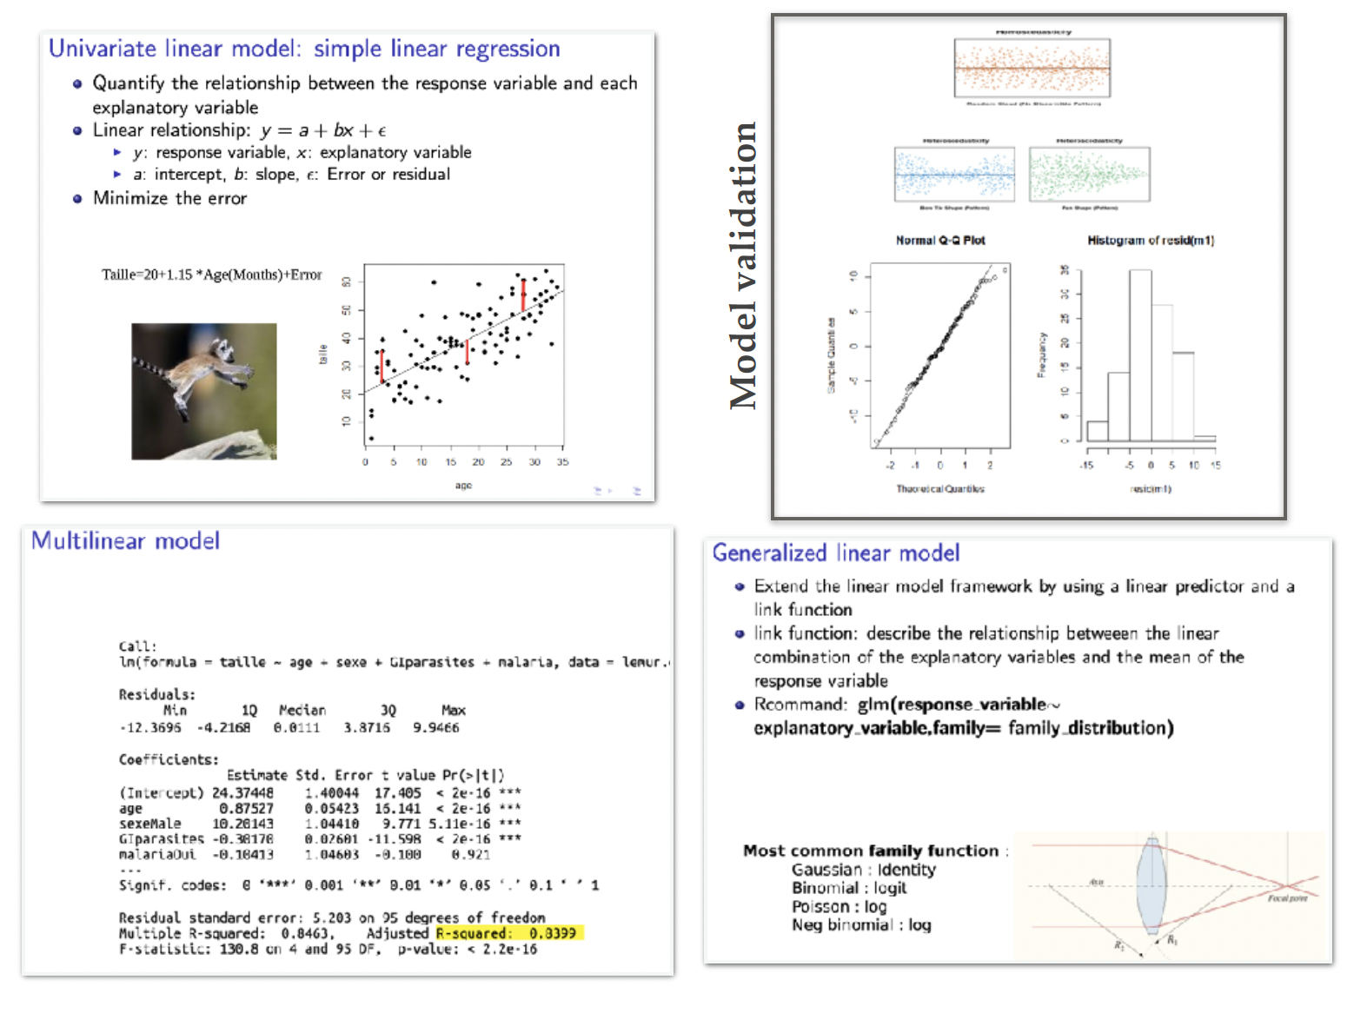
Generalized linear mixed effect models modèles linéaires généralisés à effets mixtes
Tuesday: “Applying Simple Models”
● Dynamical Fever
● Introduction to Mixed Modeling
● Reading a Research Paper

Slide 34

Generalized linear mixed effect models modèles linéaires généralisés à effets mixtes
Tuesday: “Applying Simple Models”
● Dynamical Fever
● Introduction to Mixed Modeling
● Reading a Research Paper
linear
generalized
linear regression
régression linéaire
normal distribution
lm()
generalized linear regression
régression linéaire généralisée
non-normal distribution
glm()
fixed
linear mixed model
modèle mixte linéaire
normal distribution
random effects
effets aléatoires
lmer()
generalized linear mixed model
modèle mixte linéaire généralisé
non-normal distribution
random effects
effets aléatoires
glmer()
mixed

Slide 35
Friday: R Bootcamp
Intro to R Studio
Exploring and Visualizing Data in R
For-loops, Functions, and If-Else Statements
Saturday: Travel
Sunday: “Getting Started with the Basics”
● Data and Models
● Student introductions & presentations
● Linear regression ● Tutorial
● Formulating research questions
Wednesday: “Fitting Models to Data”
● Model Fitting in Practice – the Basic Concept
● Epidemic Cards
● Model Fitting with Epidemic Cards
Monday: “Using Models with Data”
● Model-Guided Study Design
● Study design tutorial
● Intro to Compartmental Models & Differential Equations
● Building mechanistic models in R
● Refining research questions for modeling
● Defining a model world
Tuesday: “Applying Simple Models”
● Dynamical Fever
● Introduction to Mixed Modeling
● Reading a Research Paper

Slide 36
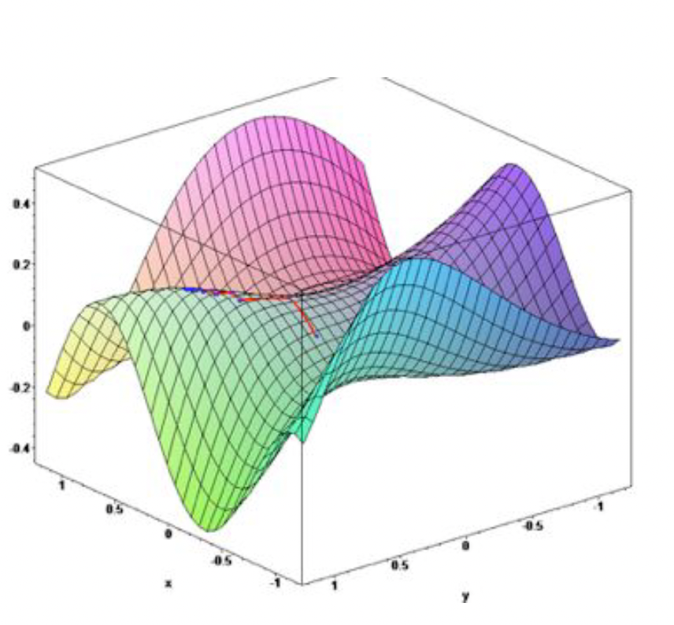
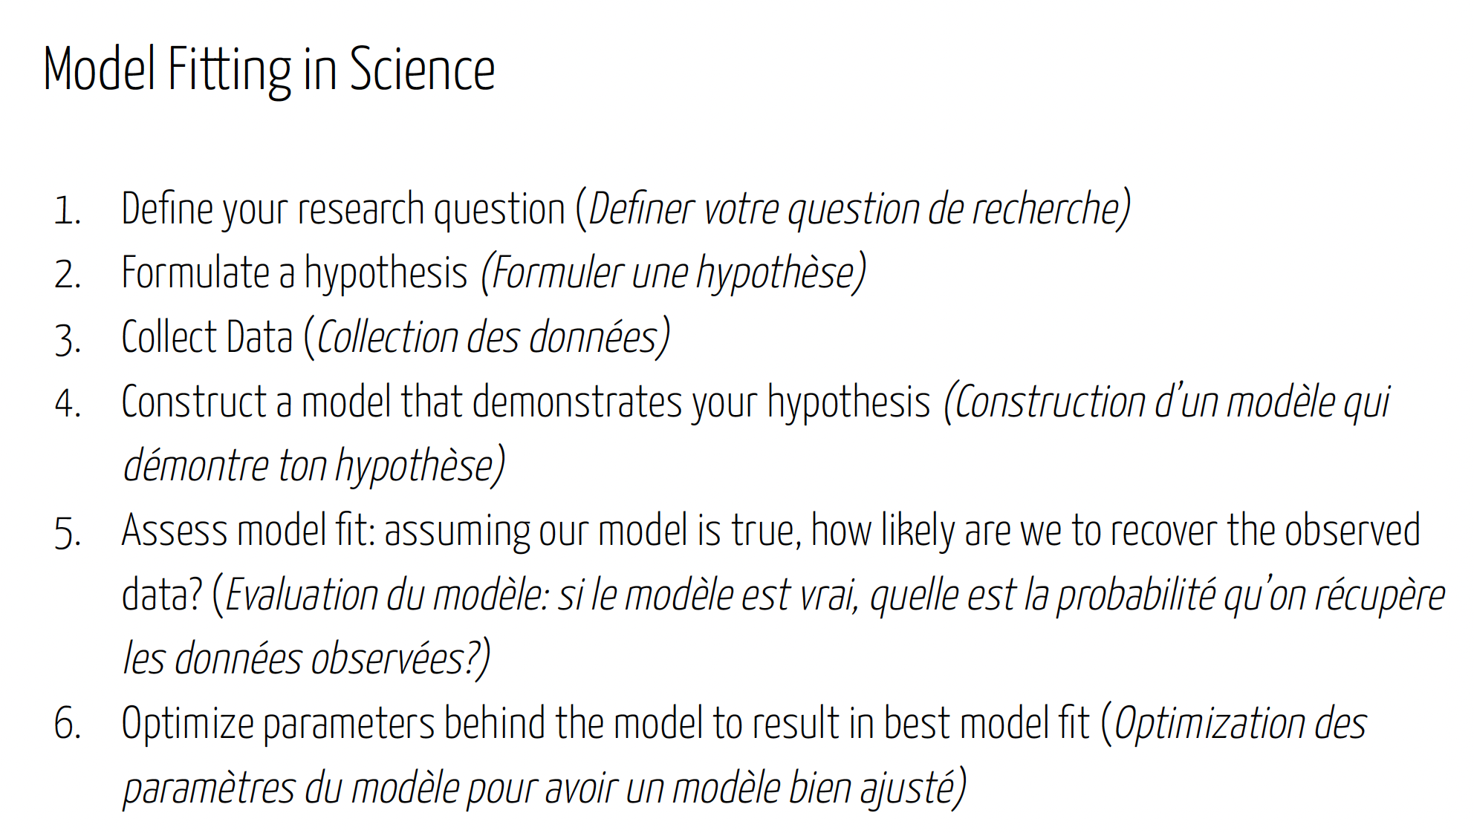
Fitting Models to Data Adapter les modèles aux données
Wednesday: “Fitting Models to Data”
● Model Fitting in Practice – the Basic Concept
● Epidemic Cards
● Model Fitting with Epidemic Cards

Slide 37
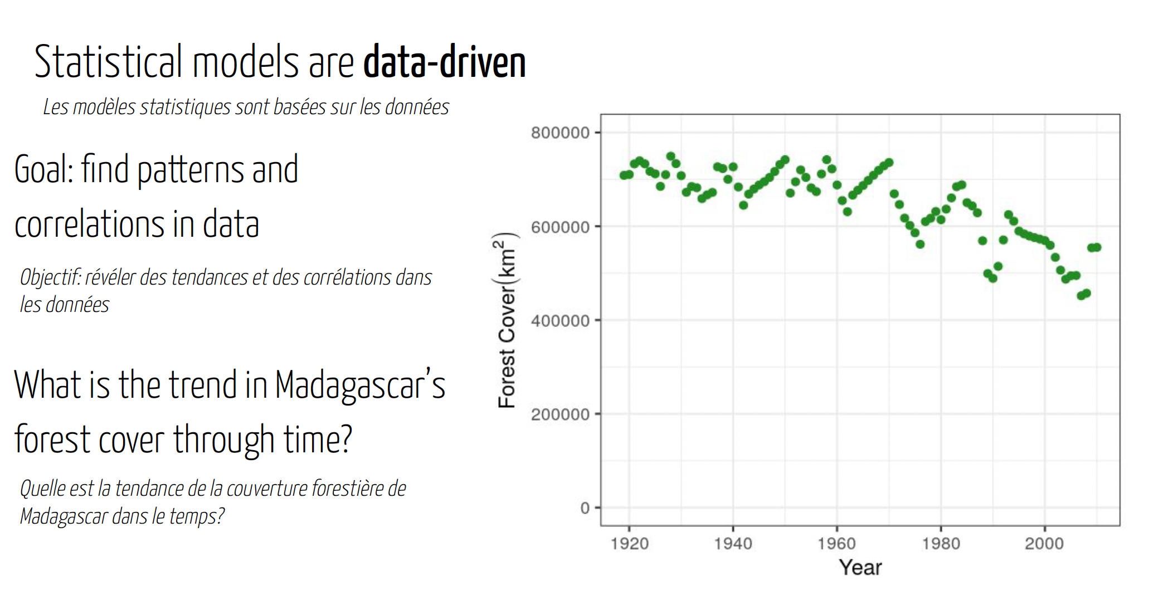
Fitting Models to Data Adapter les modèles aux données
Wednesday: “Fitting Models to Data”
● Model Fitting in Practice – the Basic Concept
● Epidemic Cards
● Model Fitting with Epidemic Cards

Slide 38
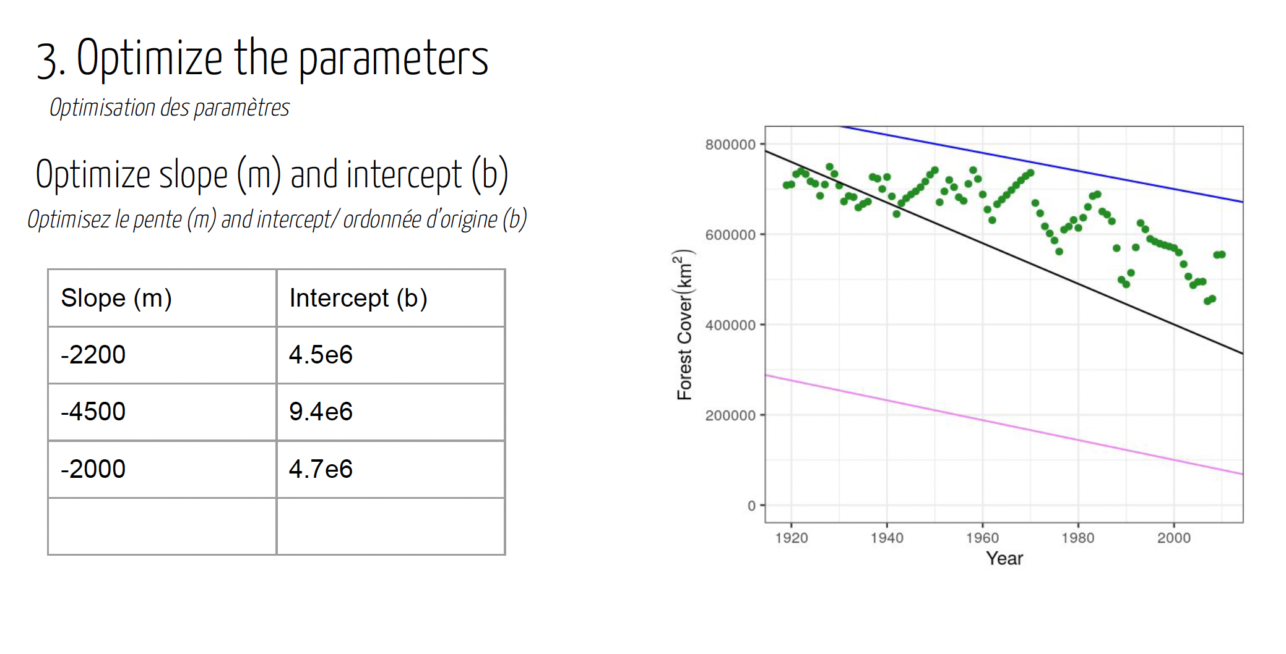
Fitting Models to Data Adapter les modèles aux données
Wednesday: “Fitting Models to Data”
● Model Fitting in Practice – the Basic Concept
● Epidemic Cards
● Model Fitting with Epidemic Cards

Slide 39
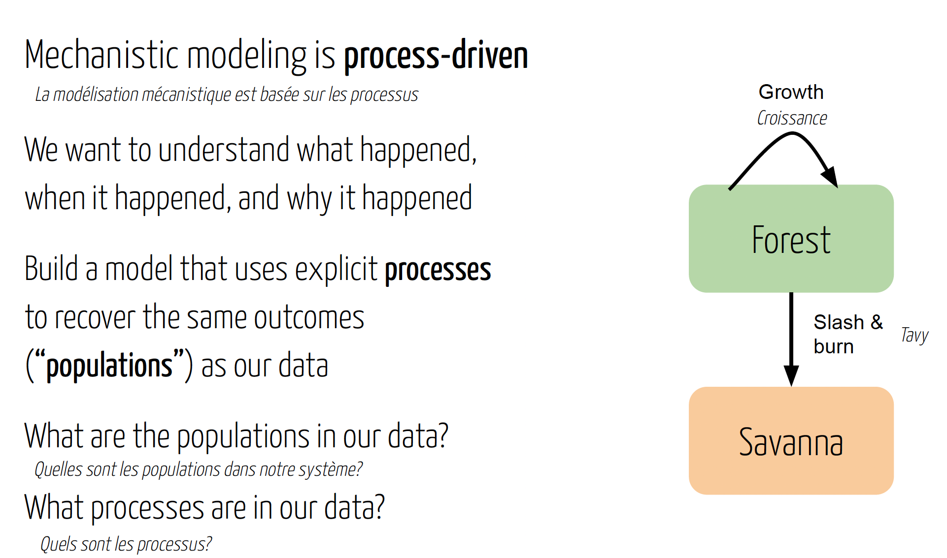
Fitting Models to Data Adapter les modèles aux données
Wednesday: “Fitting Models to Data”
● Model Fitting in Practice – the Basic Concept
● Epidemic Cards
● Model Fitting with Epidemic Cards

Slide 40
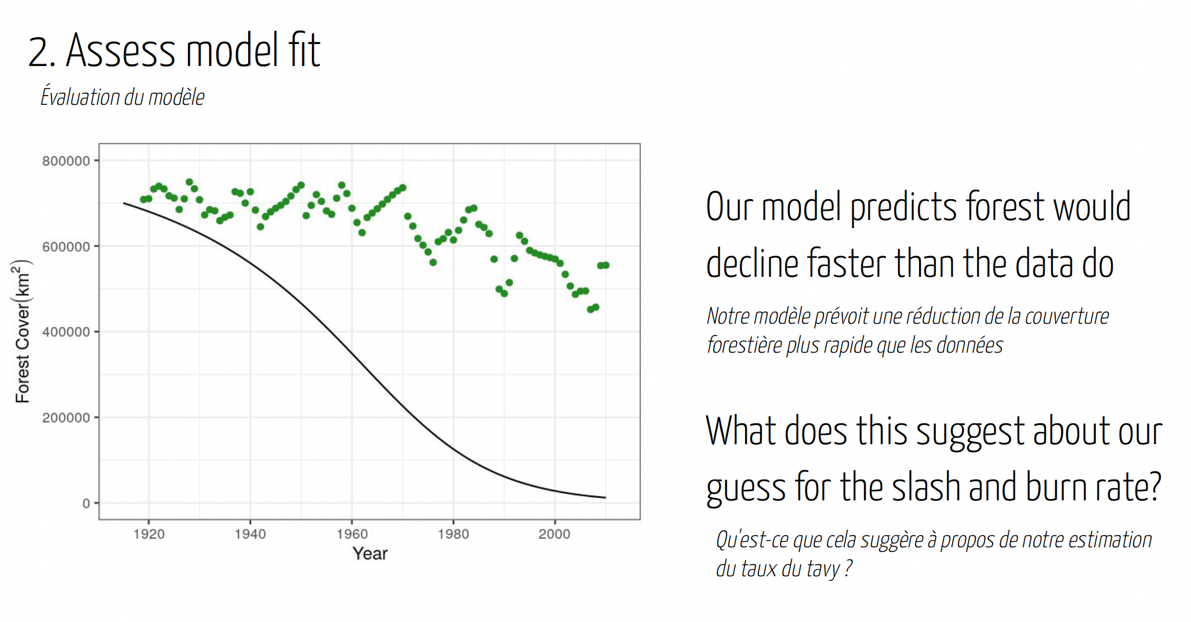
Fitting Models to Data Adapter les modèles aux données
Wednesday: “Fitting Models to Data”
● Model Fitting in Practice – the Basic Concept
● Epidemic Cards
● Model Fitting with Epidemic Cards

Slide 41
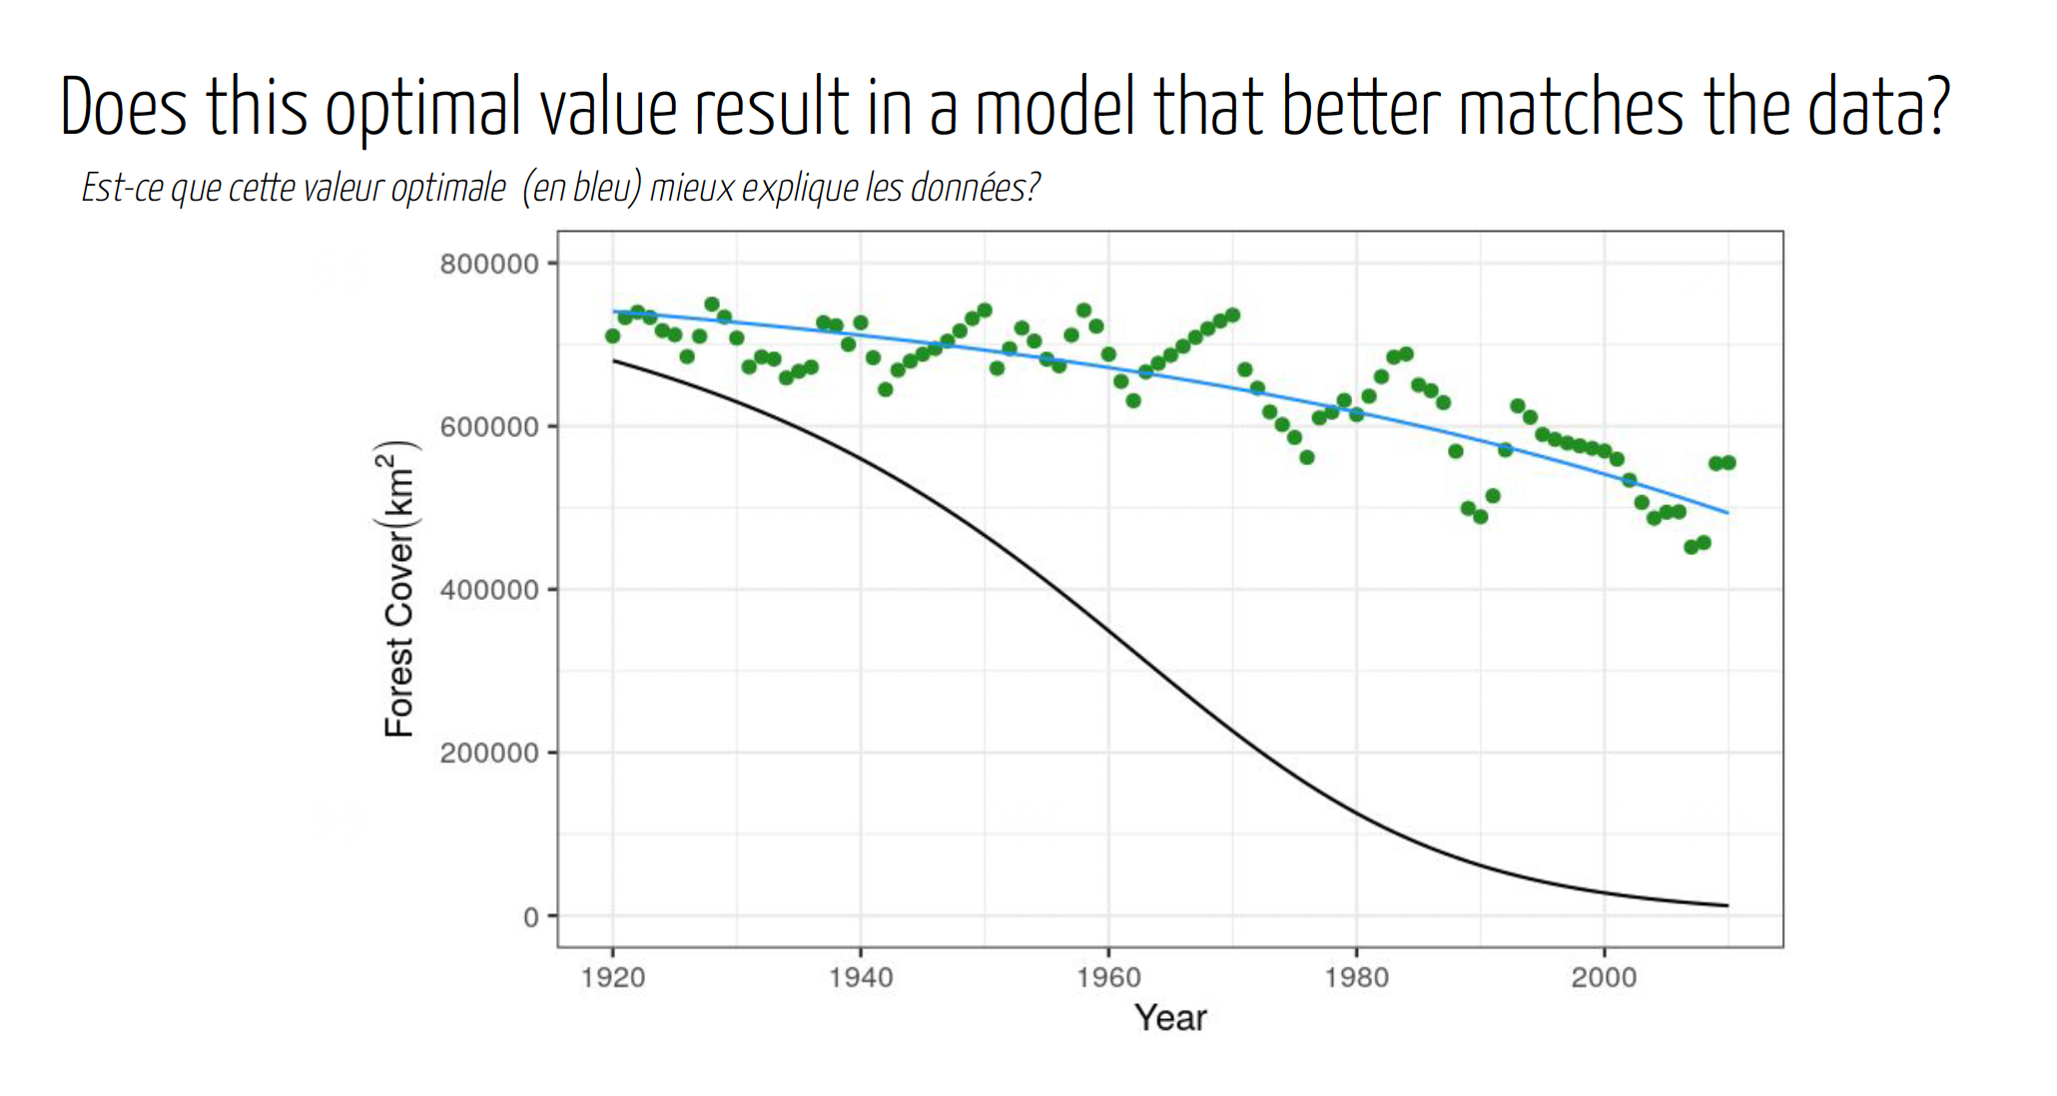
Fitting Models to Data Adapter les modèles aux données
Wednesday: “Fitting Models to Data”
● Model Fitting in Practice – the Basic Concept
● Epidemic Cards
● Model Fitting with Epidemic Cards

Slide 42
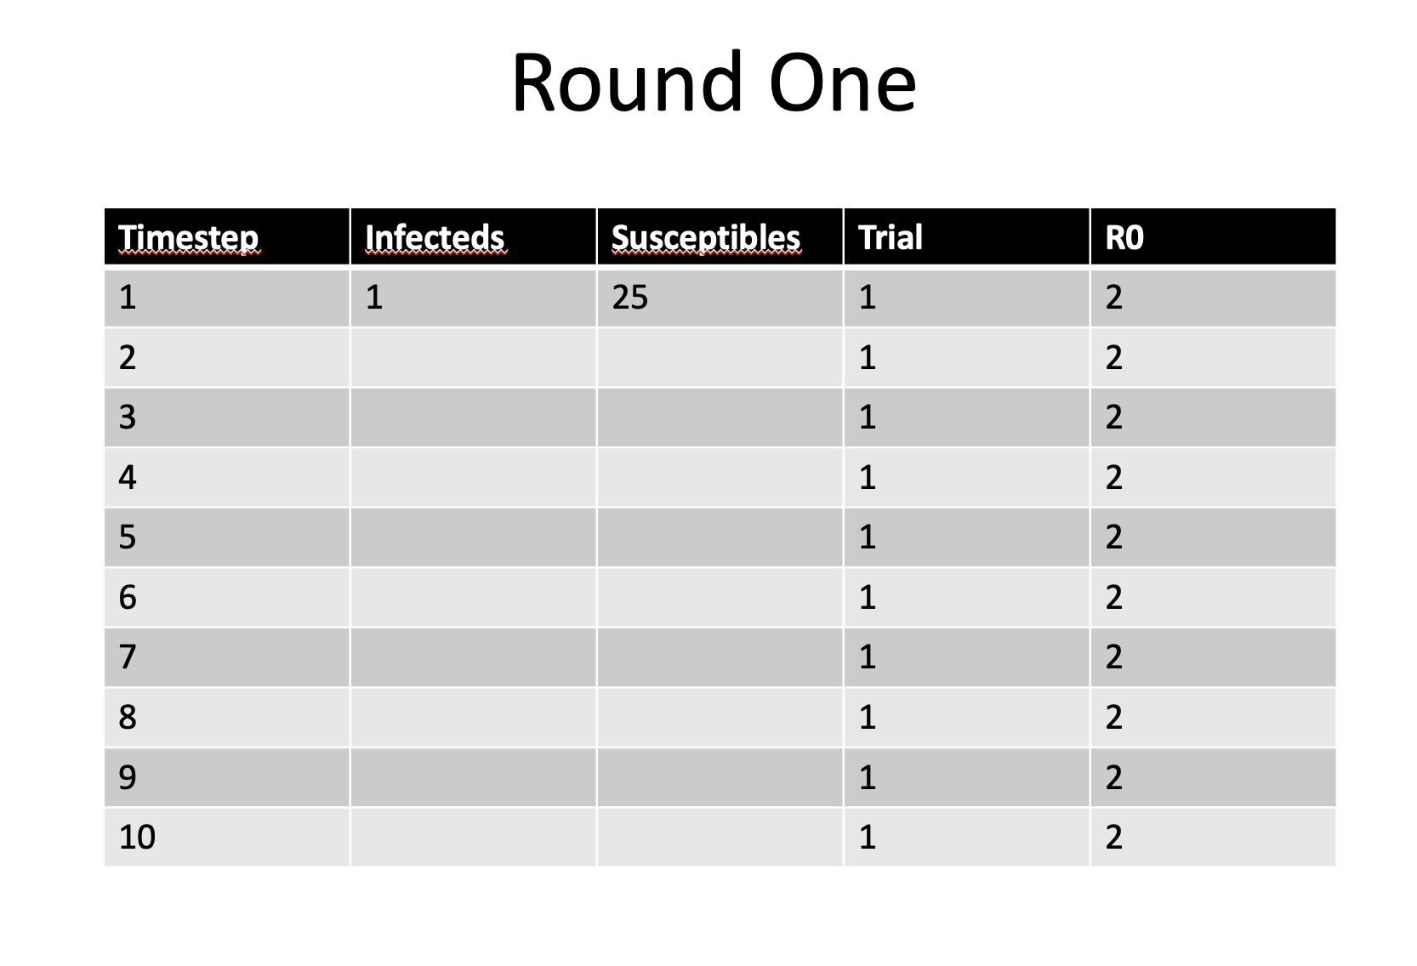
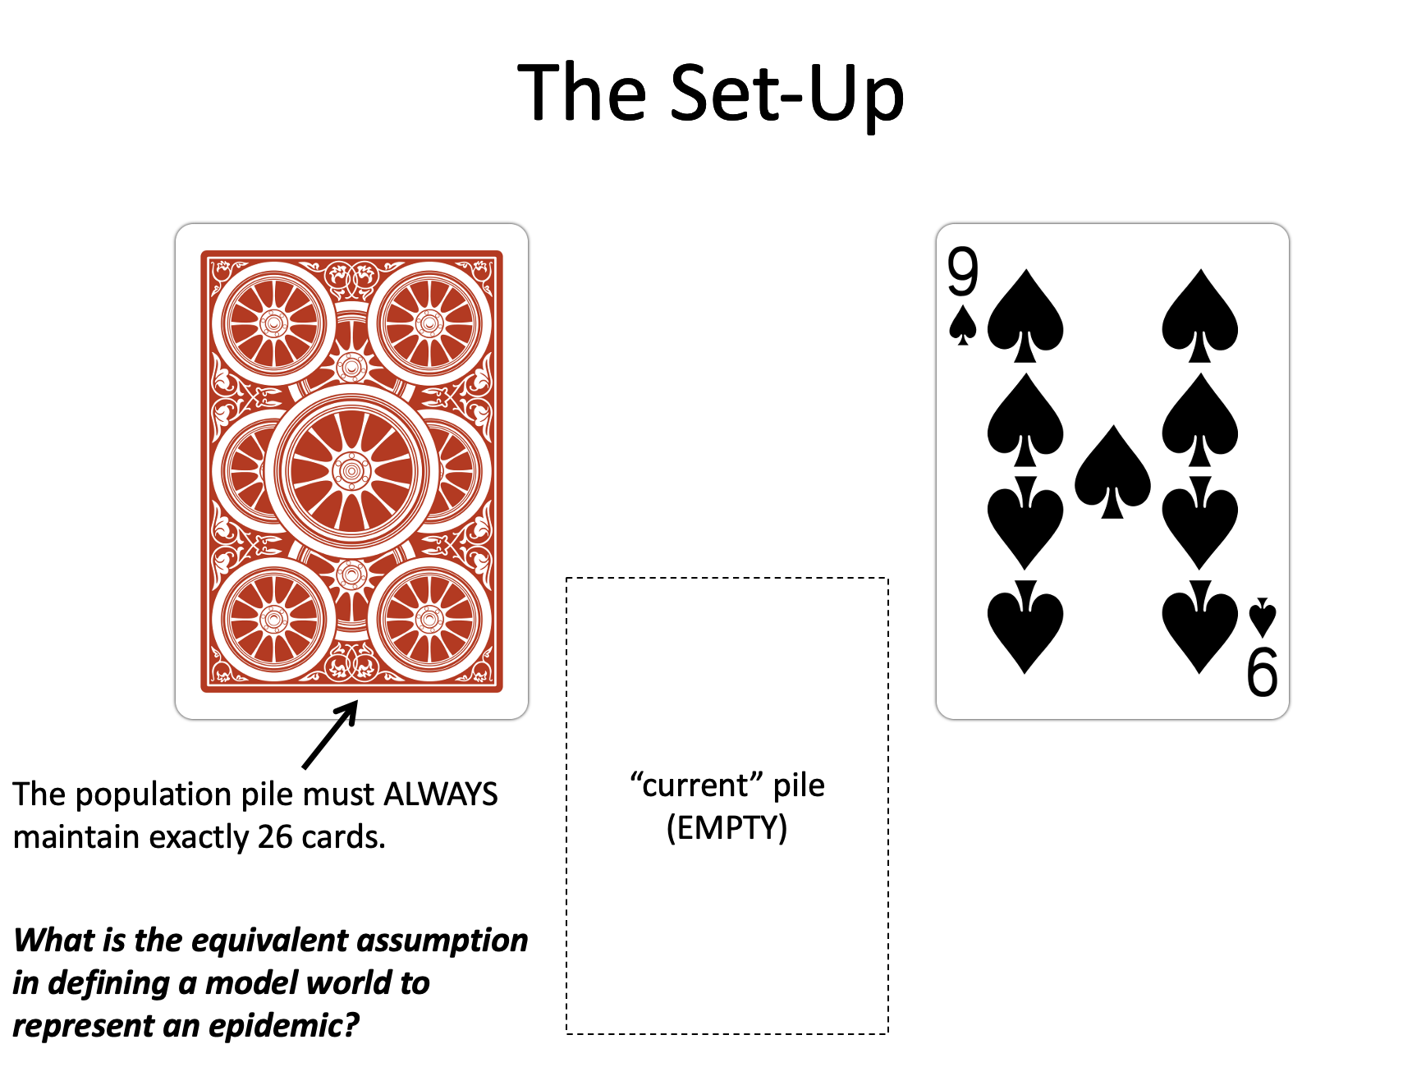
Epidemic Cards Cartes Épidémie
Wednesday: “Fitting Models to Data”
● Model Fitting in Practice – the Basic Concept
● Epidemic Cards
● Model Fitting with Epidemic Cards

Slide 43
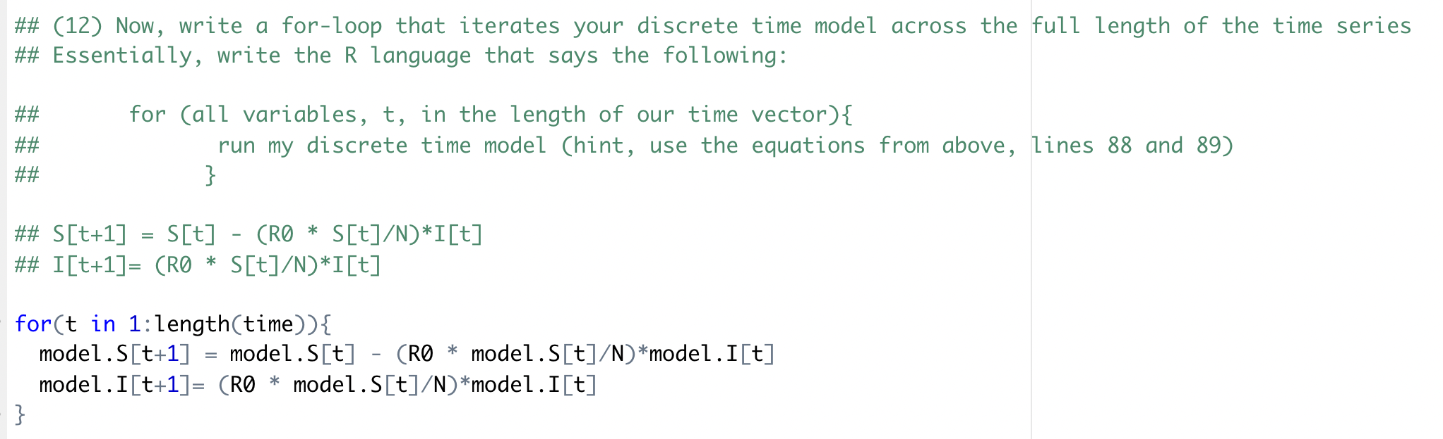
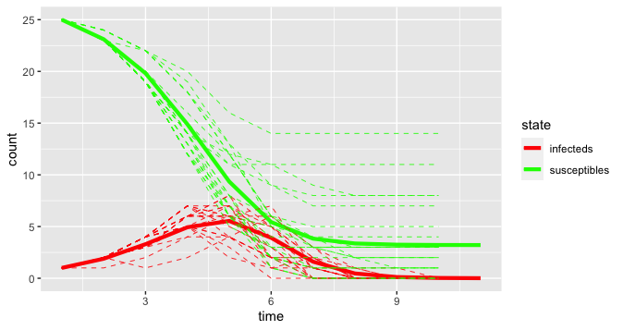
Epidemic Cards Cartes Épidémie
Wednesday: “Fitting Models to Data”
● Model Fitting in Practice – the Basic Concept
● Epidemic Cards
● Model Fitting with Epidemic Cards

Slide 44

Model Telephone Modèle de téléphone
Thursday: “Refining Your Work + Bells and Whistle”
● Model Telephone
● Model Selection and Comparison ● Tutorial
● Introduction to Phylogenetic Modeling ● Tutorial
● Introduction to Network Modeling ● Tutorial
● Research Snapshots

Slide 45
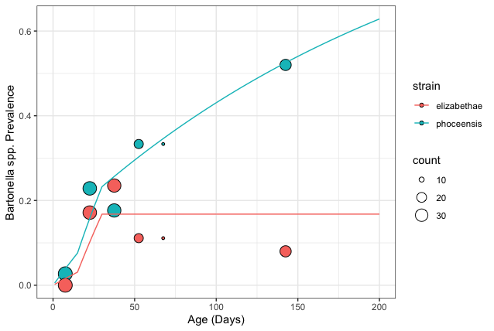
Model Selection and Comparison Sélection et comparaison de modèles
Thursday: “Refining Your Work + Bells and Whistle”
● Model Telephone
● Model Selection and Comparison ● Tutorial
● Introduction to Phylogenetic Modeling ● Tutorial
● Introduction to Network Modeling ● Tutorial
● Research Snapshots
λ
S
I
λ
S
I
σ

Slide 46
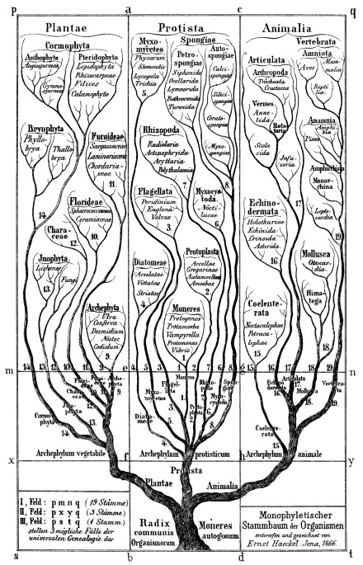
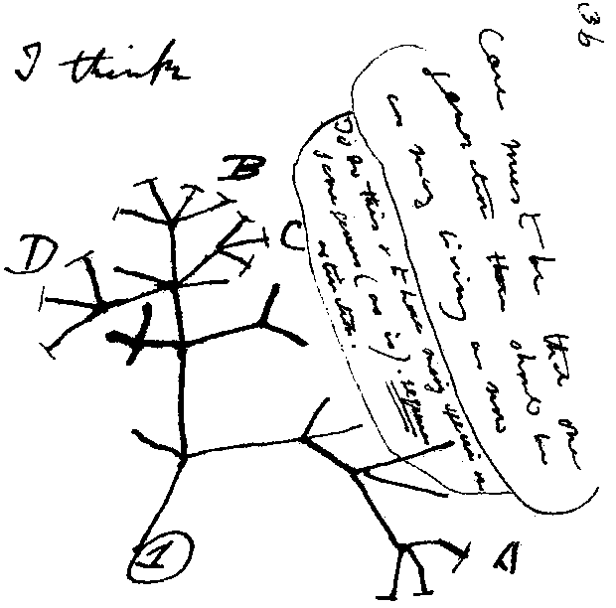
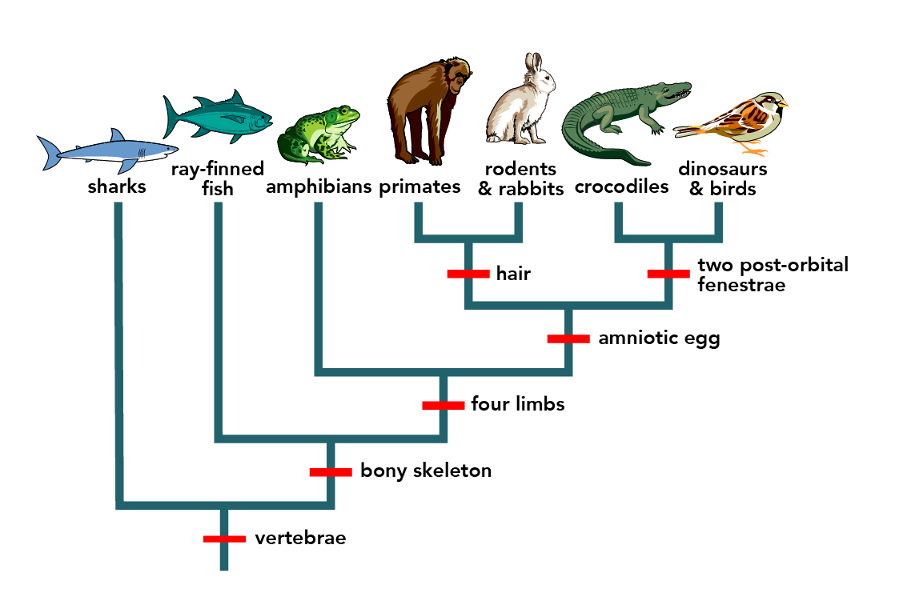
Intro to Phylogenetic Modeling Introduction à la modélisation phylogénétique
Thursday: “Refining Your Work + Bells and Whistle”
● Model Telephone
● Model Selection and Comparison ● Tutorial
● Introduction to Phylogenetic Modeling ● Tutorial
● Introduction to Network Modeling ● Tutorial
● Research Snapshots
Hossfeld and Levit, Nature, 2016

Slide 47
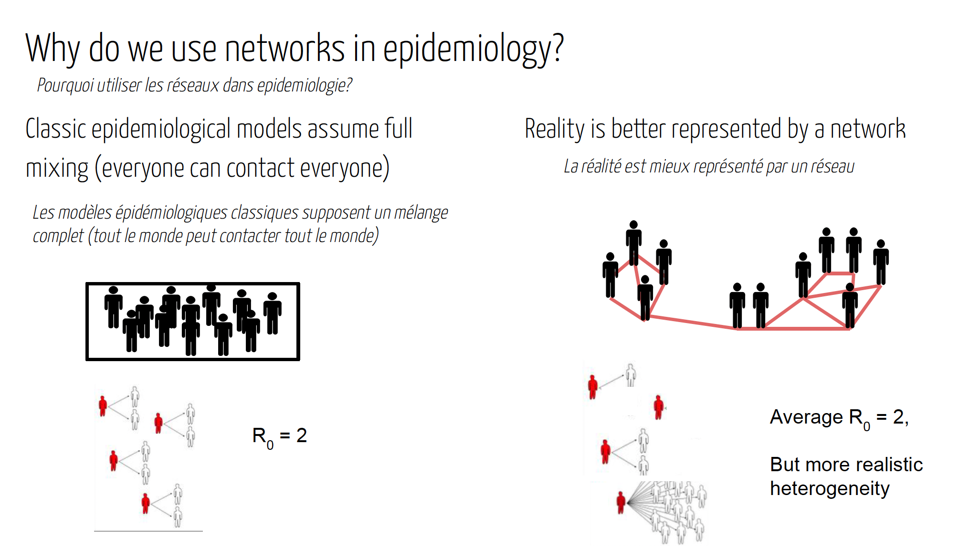
Intro to Network Modeling Introduction à la modélisation de réseau
Thursday: “Refining Your Work + Bells and Whistle”
● Model Telephone
● Model Selection and Comparison ● Tutorial
● Introduction to Phylogenetic Modeling ● Tutorial
● Introduction to Network Modeling ● Tutorial
● Research Snapshots

Slide 48
Friday: R Bootcamp
Intro to R Studio
Exploring and Visualizing Data in R
For-loops, Functions, and If-Else Statements
● Programming
● Data
● Models
● Research Development
Thursday: “Bells and Whistle”
● Introduction to Phylogenetic Modeling ● Tutorial
● Intoduction to Spatial Visualization and Plotting ● Tutorial
● Modeling Insights from the Metapopulation Game ● Tutorial
● Introduction to Network Modeling ● Tutorial
● Research Snapshots
Saturday: Travel
Sunday: “Getting Started with the Basics”
● Data and Models
● Student introductions & presentations
● Linear regression ● Tutorial
● Formulating research questions
Wednesday: “Refining Your Work”
● Model Fitting in Practice – the Basic Concept
● Epidemic Cards
● Model Fitting with Epidemic Cards
● Model Selection and Comparison
● Model Selection Tutorial
● Model Telephone
Friday: “Putting it All in Perspective”
● The Life Cycle of a Modeling Project
● C4C Student Presentations
Saturday: Travel
Monday: “Using Models with Data”
● Model-Guided Study Design
● Study design tutorial
● Intro to Compartmental Models & Differential Equations
● Building mechanistic models in R
● Refining research questions for modeling
● Defining a model world
January: “Sharing Your Work”
● Final student presentations
Tuesday: “Applying Simple Models”
● Dynamical Fever
● Introduction to Mixed Modeling
● Reading a Research Paper

Slide 49
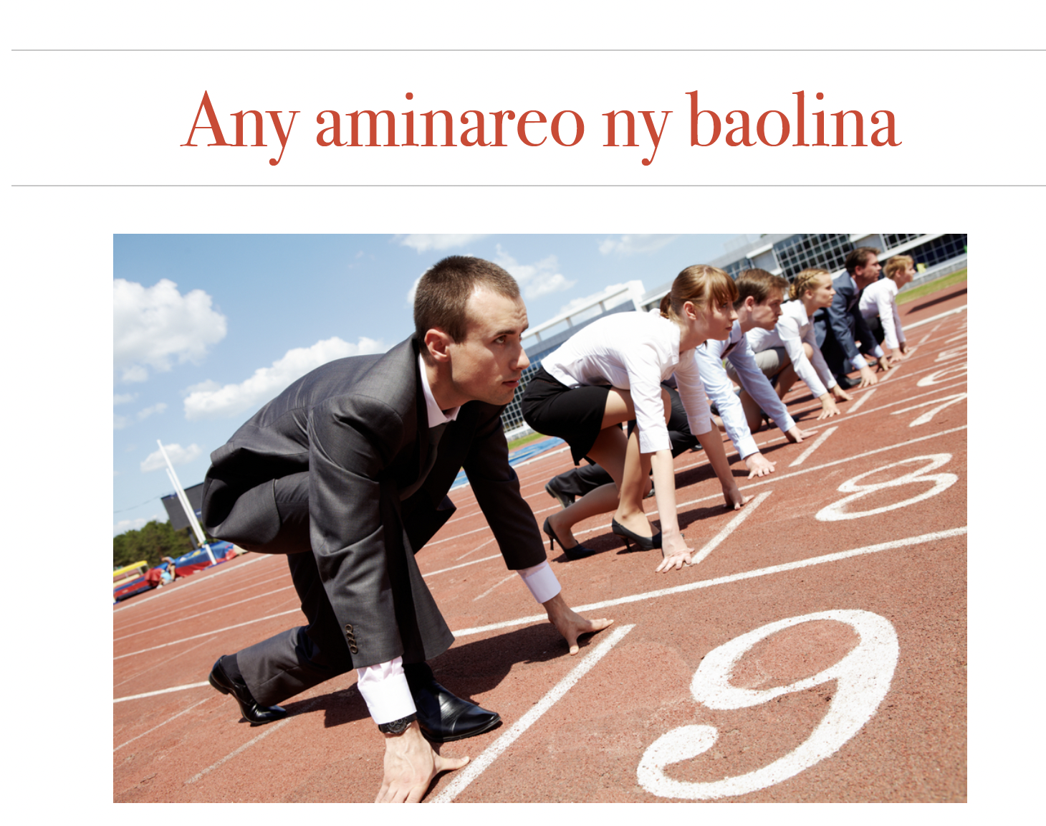

Slide 50
